Slide 1
Workload Solution Tech talk: Juju & charms
Xiaogang Zhou, Feng Xia
4/20/2017

Slide 2
Agenda
Workload Solution Project intro
Juju intro
Charm intro
- demo: states
Charm deploy
- demo: Openstack
Charm development

Slide 3
Workload Solution Project

Slide 4
Function Architecture – Level 1
Blueprints
Blueprints
Descriptive template that defines workload states, actions, interfaces, and relations.
Hardware
Ie. ThinkAgile
Platform
Ie. Openstack
User application
Ie. Hadoop
Orchestration
Orchestration technology
Technology that defines terminologies, vocabulary, and runtime engine that enable automated blueprint deployment.
Description language
Orchestration runtime engine
Platform
Platform
Public cloud
Private cloud
Baremetal
Host environment that supports workload requirements and scales dynamically .

Slide 5




System architecture overview
Blueprints
Command to deploy a workload
Hardware
configuration
ie. ThinkAgile
Software platform
Id. Openstack
User application
Ie. Hardoop
Workload metadata
Orchestration manager
3rd party software repo
Baremetal
provider
Cloud provider
ManageIQ
EC2
Ironic
Openstack
xClarity
Rackspace
Node state
Application state
MaaS
Azure
……
……
Platform specific instructions
Workload blueprints
Private Cloud
Public Cloud
Workload software payload

Slide 6
Juju intro

Slide 7
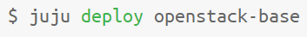
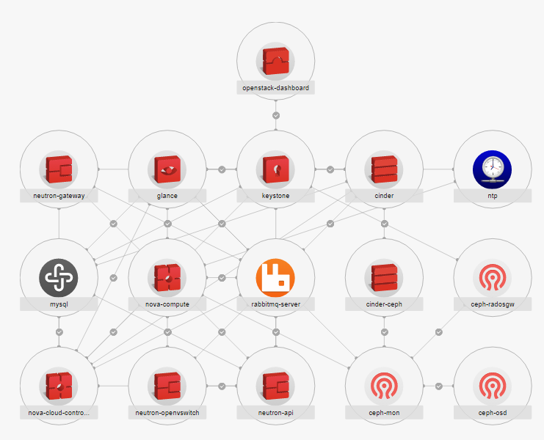
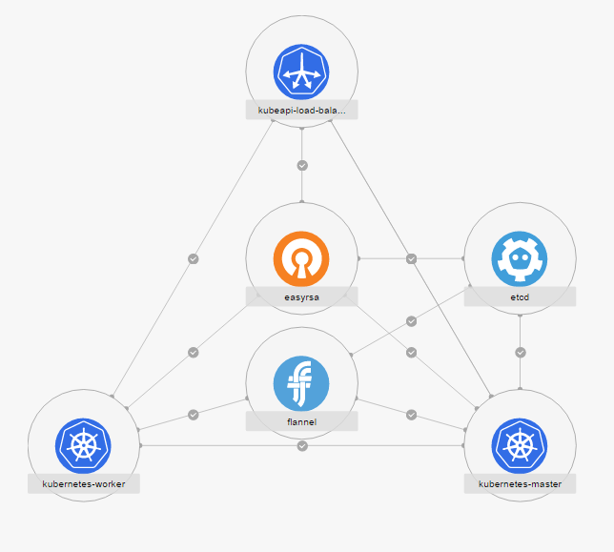
Example use cases
Charm is a workload description, and Juju and Juju agent are the runtime.

Slide 8
Juju model
Juju binary
$ juju add-machine ….
$ juju deploy mysql
Providers:
provider
Azure
Cloudsigma
Amazon EC2
GCE
Joyent
Openstack
Rackspace
Vsphere
Canonical MAAS
LXD containers
Manual
$ juju bootstrap
$ give me a machine
Juju environment
MongoDB
Manager node
machine-0
Cloud provider interface
eg. NOVA API
API calls
provider
Juju agent
Cloud’s native
management
Machine
Machine
Machine
Juju agent
Juju agent
Juju agent

Slide 9
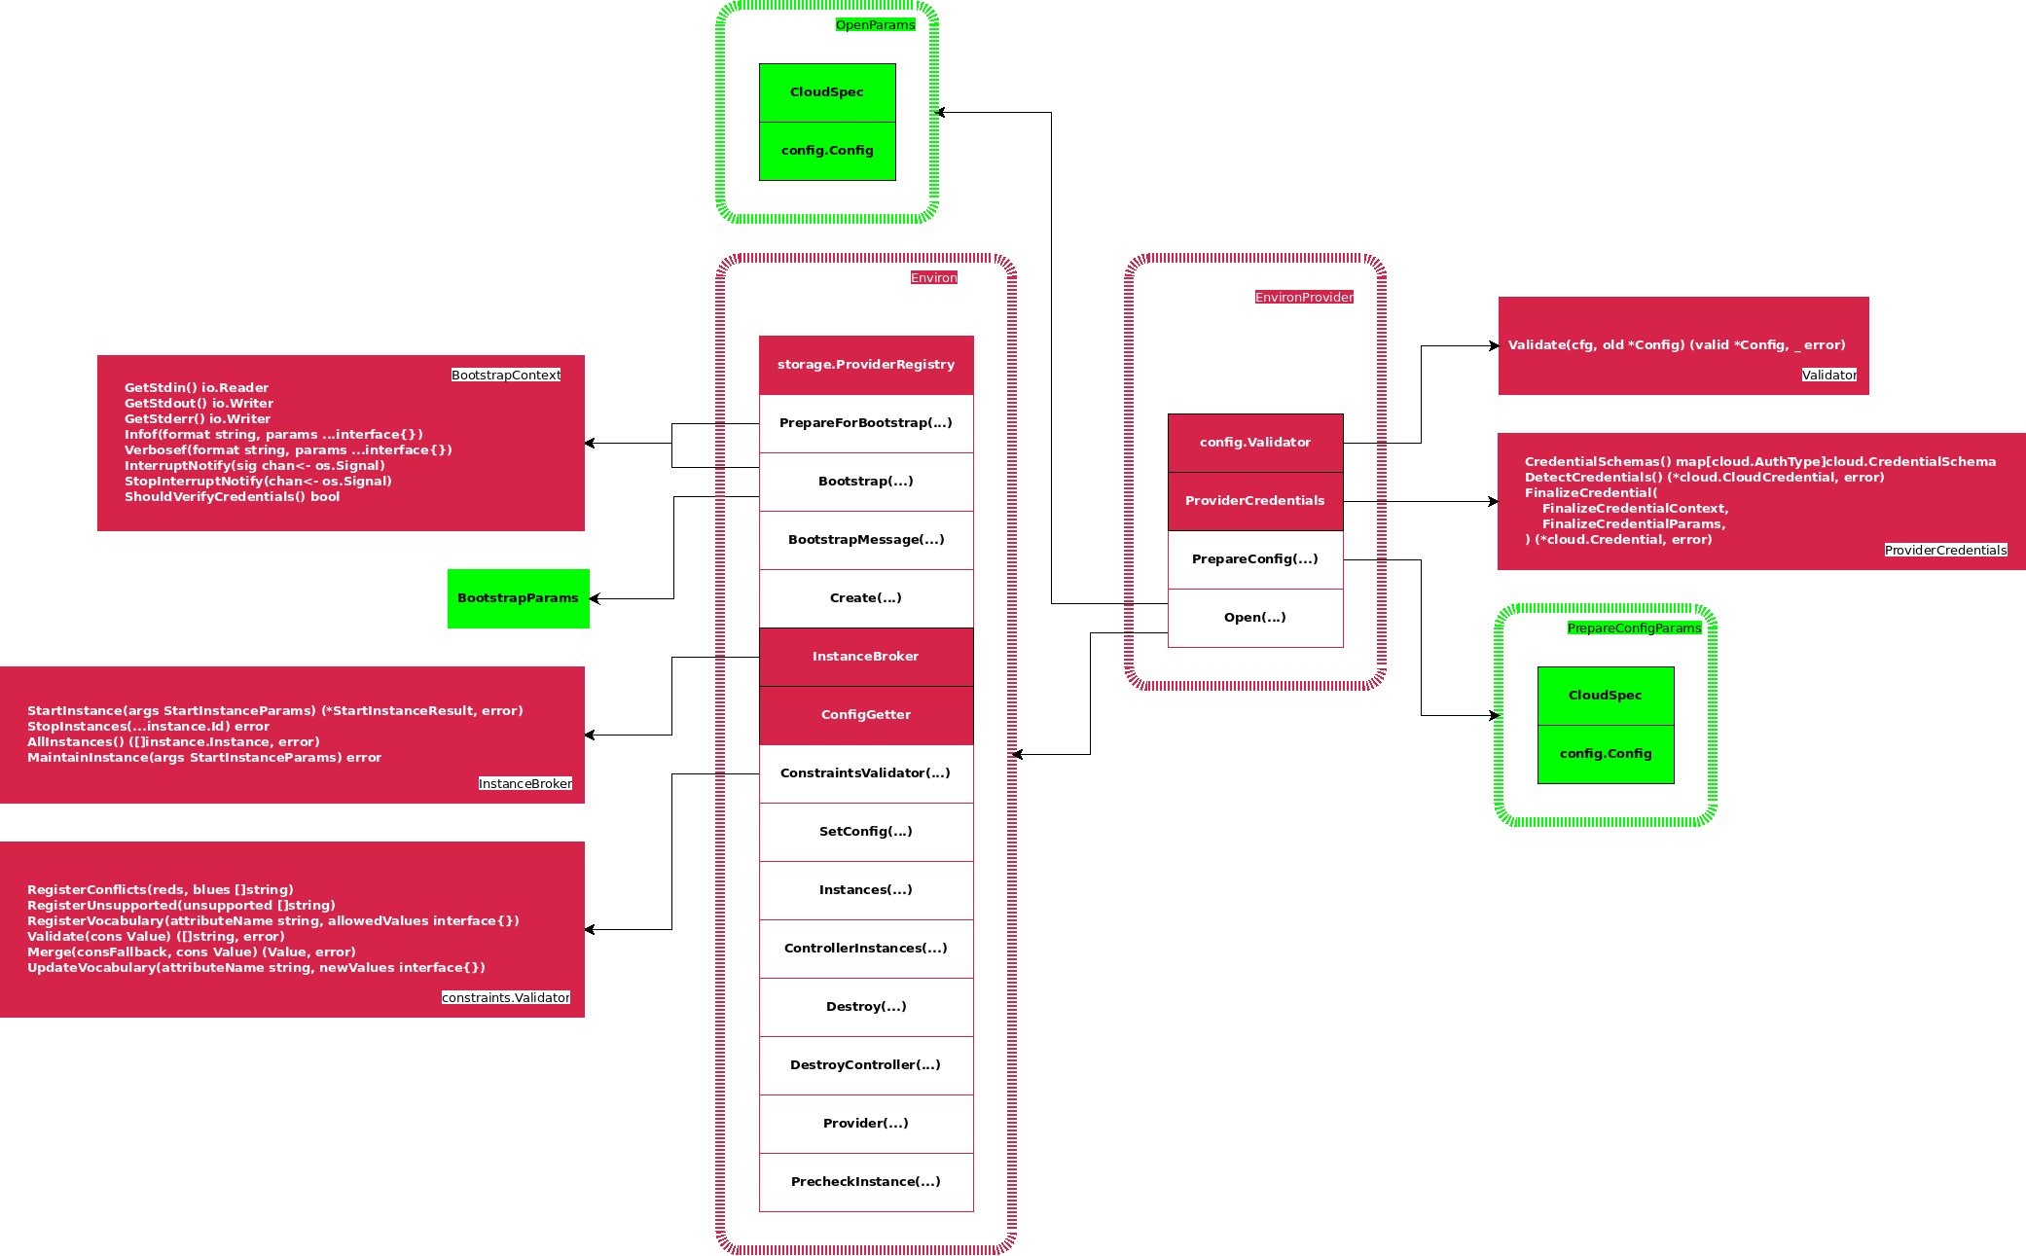
Juju provider interface
Provider interface
Legend:
Red: interface
Green: static struct
(): func
- Give me a machine: StartInstance()
- Decommission: StopInstances()

Slide 10
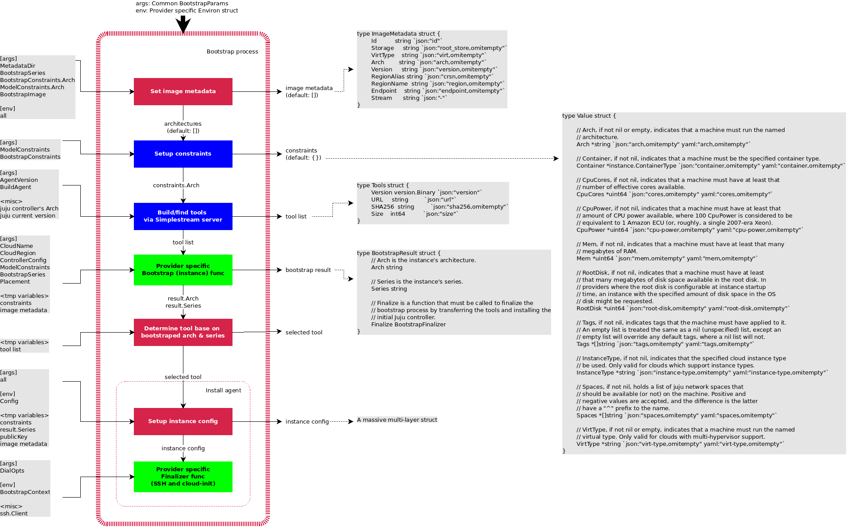
Juju bootstrap process
Legend:
Green: provider hook
Tool = Juju agent
hook
hook

Slide 11
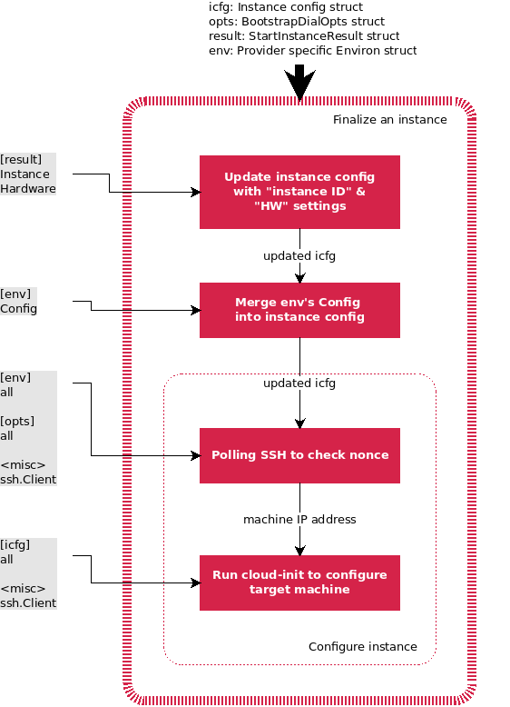
Juju bootstrap finalizer
1. Dir: /var/lib/juju
2. Machine identity: none.txt
3. Provision done: SSH polling
4. Agent & pkg install: cloud-init

Slide 12
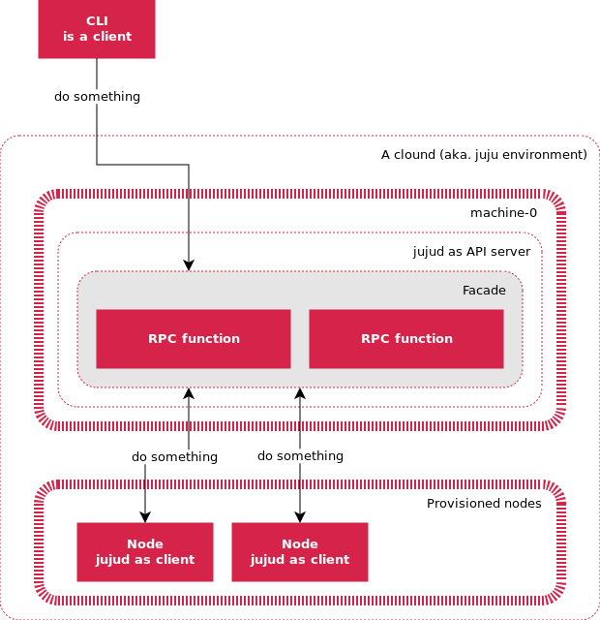
jujud the agent
Agent is distributed on each deployment target machine.
Agent is installed as part of node provisioning process, then runs as systemd service.
Agent communicates to management node via websocket transportation layer (on server port 17070).
API server provides the same RPC interface for both workload agent and CLI tools.
Agent has a unique ID and credential issued by manager node.

Slide 13
Charm intro

Slide 14
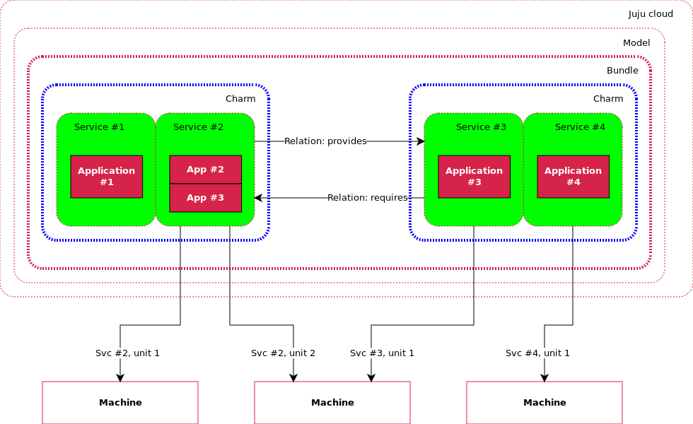
Charm intro
Base unit is a service.
Service can have more than 1 unit to achieve HA.
Deployment can be on BM, VM, and LXD container.
Relation parity
High availability

Slide 15
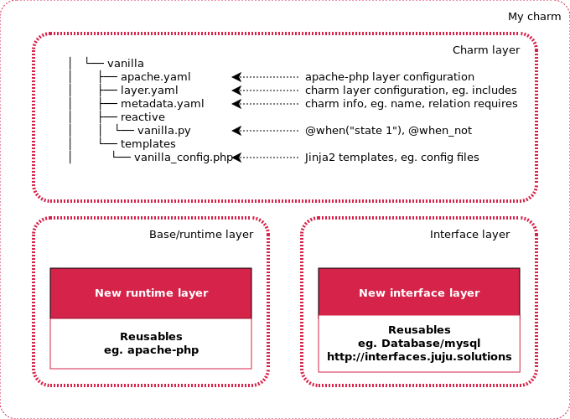
Reactive workload & layer
Base layer
Provides foundation service that can be reused.
Interface layer
Defines service that can be connected to, eg. DB. Parameters are managed by charm; connection method is determined by the application.
Application layer
Defines states, hooks and application logics.
Notes:
Base layer
Interface layer defines service that can be “connected” to, eg. DB. Parameters are passed via interface; how to connect is determined by application, not charm.
Charm layer defines “states”, “hooks”, and application logics.

Slide 16
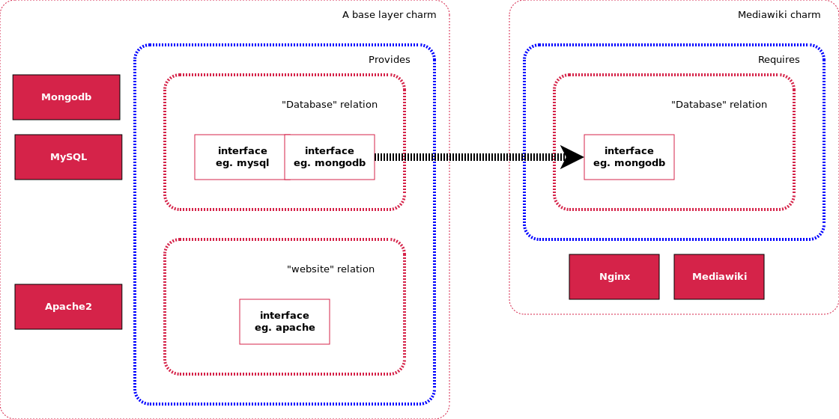
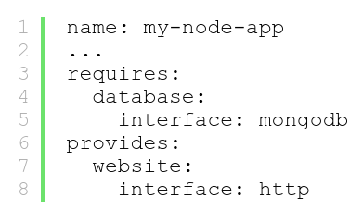
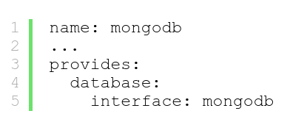
Charm interface parity
Interface must match
Define a relation name

Slide 17
Hooks
Hooks:
Use @hook(“…”)
Sequence is hard-coded in juju/worker/uniter/operation/runhook.go
install
upgrade-charm
User upgrade
machine-0
config-changed
start
Hookenv.config() changed
Main loop
User stop
update-status
stop
Timer loop

Slide 18
States
States:
@when, @when_not, @when_all….
Can be split among layers, but
not across charms
not across unit
Fire at state F->T transition only => reset in handler
Multiple “true” are queued
How are states executed:
1. Register: charmhelpers.core.hookenv.discover()
all .py under /reactive, /hooks/reactive, /hooks/relations are imported.
all executable files (scripts) must support 2 flags: --test and --invoke
2. Scan: charmhelpers.core.hookenv._run_atstart()
3. Dispatch in two phases: hooks (while) & others (for 1:100) => not interruptable, max 100 states(?)
START
set_state(‘state.1’)
State.1
set_state(‘state.2’)
State.2
set_state(‘state.1’)
set_state(‘state.3’)
State.3
Demo: chained states
Notes:
@when_not(‘a’)
Def this():
set_state(“b”)
pass
@when(‘b’)
Def that():
set_state(“c”)
pass
Import time
time.time() => 9834092492094.998
time.ctime(time.time()) => Fri 10:17 May 01, 2017
with open(“/tmp/juju.log”,’a’) as f:
f.write()

Slide 19
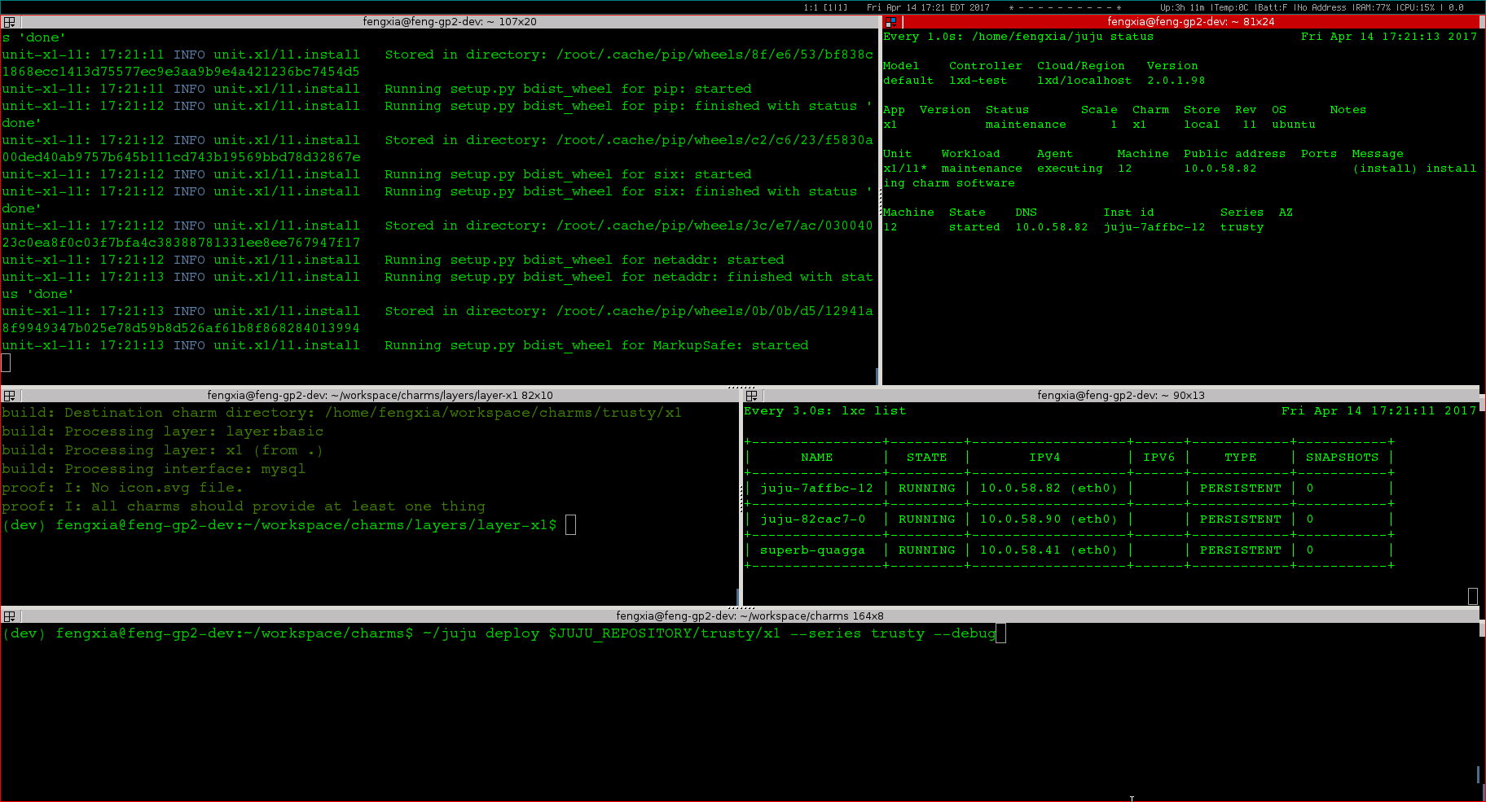
Demo: chained-states

Slide 20
Charm deploy

Slide 21
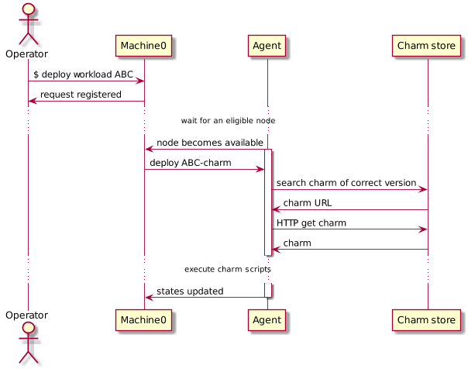
Workload orchestration sequence diagram
Machine-0
Manager node. One per cloud environment. Keep agent states, serve CLI request, and command agents.
Agent
Runtime workload orchestrator. Distributed on each target node.
Charm store
Workload repository. Can be both local & remote.

Slide 22
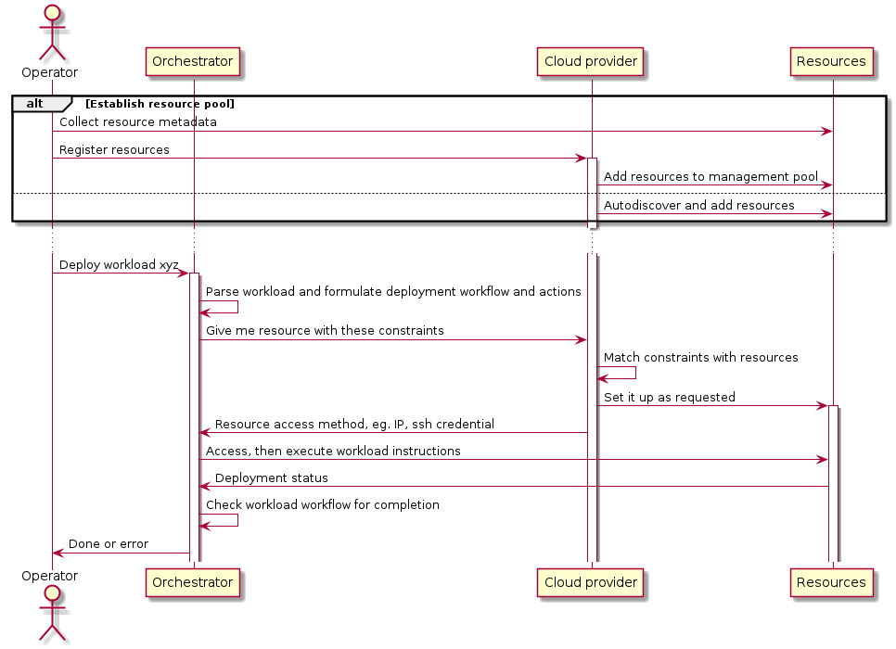
Deployment pattern 1 – pooled resource
Notes:
Pattern 1: resources metadata are registered before they become available for consumption, whereas in pattern 2 resource is created on the fly.

Slide 23
Juju+MaaS setup
VM #1
Issue JUJU CLI
Management network
10.240.216.0/23
MaaS provider
MaaS REST API
MAAS
rack controller
VM #2
Provision network
192.168.100.0/24
DHCP, image
Workload
XYZ
JUJU
Machine-0
Manager node
VM #N
VM #3
JUJU
GUI
VM #4
BM

Slide 24
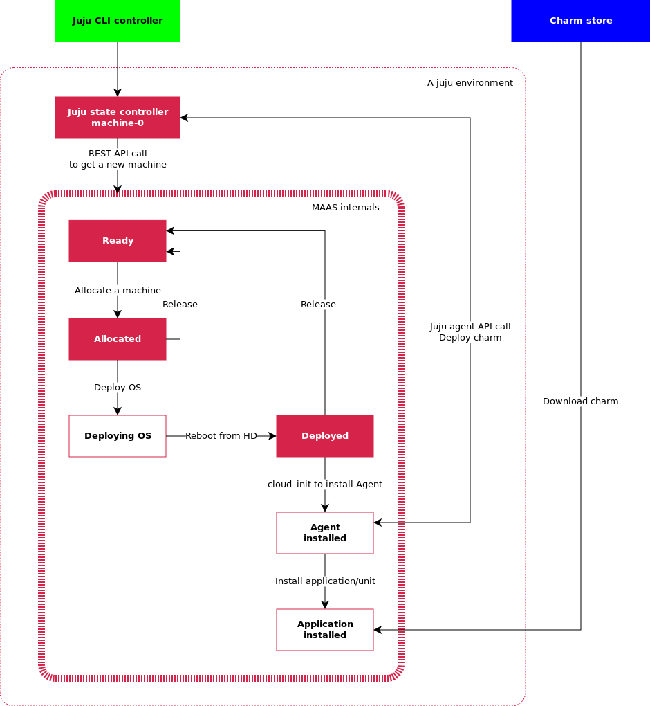
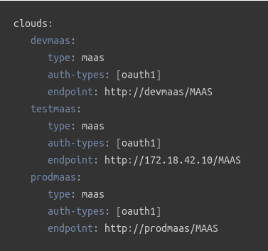
Pattern 1 example – Juju + MaaS
Prepare MaaS and BM nodes – NEW, commissioning, READY
Bootstrap Juju environment – create manager node, aka. Machine-0
To add a cloud:
$ juju add-cloud devmaas maas-clouds.yaml

Slide 25
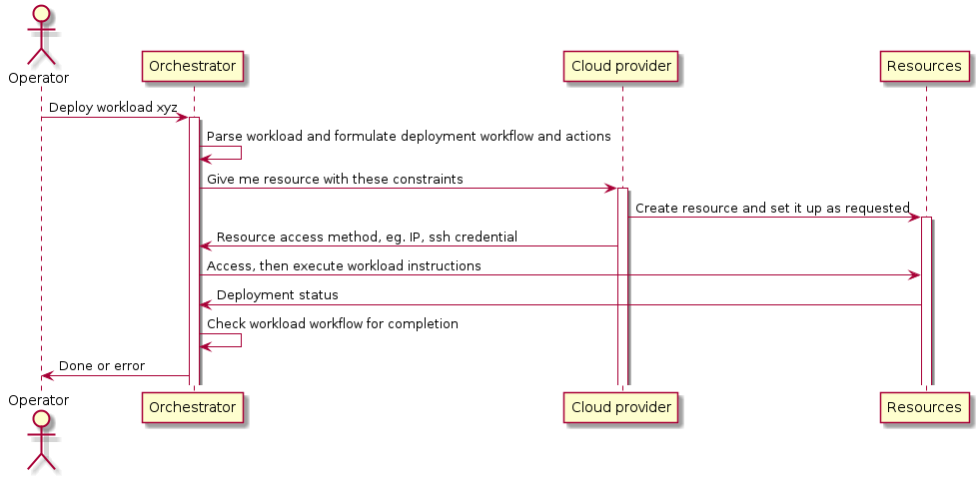
Deployment pattern 2 -- ondemand
Notes:
Pattern 2: is an ideal that resource can be created on the fly, which is observed in juju creating LXD container when deploying workload, eg. openstack base. In the end, we want the entire system appear to operator to have this capability by hiding complexity within the system.

Slide 26
Juju+LXD setup
Issue JUJU CLI
lxdbr0
veth
veth
veth
Container internal network
192.168.100.0/24
eth0
eth0
Workload
XYZ
JUJU
Machine-0
Manager node
CT #N
eth0
CT #3
JUJU
GUI
CT #4
LXD containers
VM #1

Slide 27
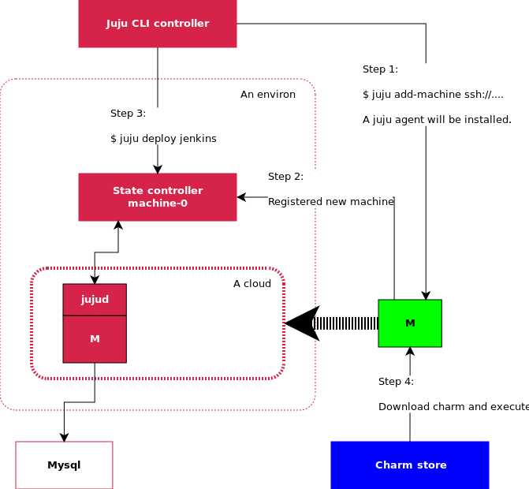
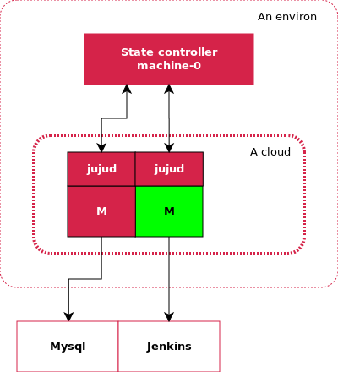
Deploy before & after
Before
After

Slide 28
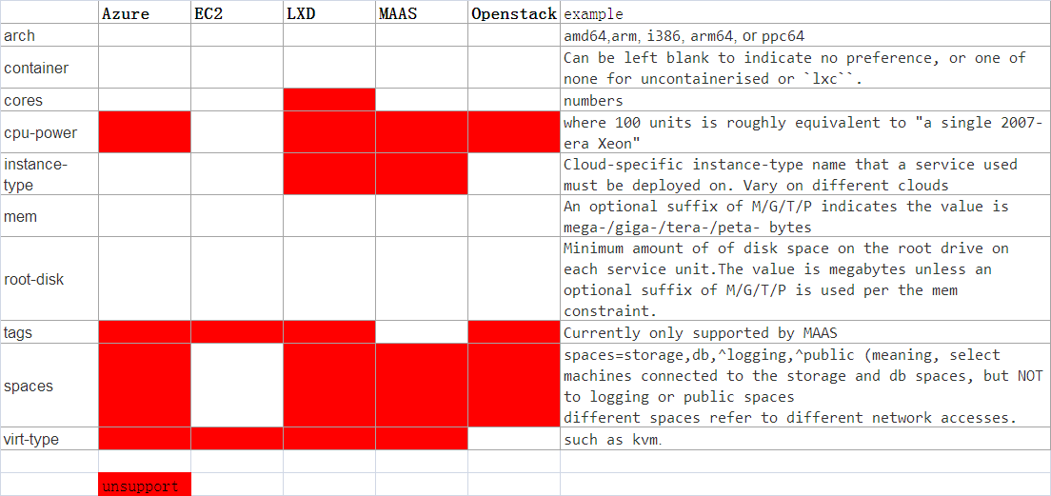
Constraints
juju CLI switch: --constraints mem=4G cores=2
Environment (boostrap) constraints are used as default. CLI can overwrite case-by-case.
Strategy: least expansive
Notes:
Need to fingure out
{ "name":"default", "model-uuid":"719d9a06-3d86-44fa-8e4d-e65232c8a84c", "controller-uuid":"4b112187-fa26-401e-8116-e21ac2dd868a", "controller-name":"lxd-test", "owner":"admin", "cloud":"lxd", "region":"localhost", "type":"lxd", "life":"alive", "status":{ "current":"available", "since":"2017-04-06" }, "users":{ "admin":{ "display-name":"admin", "access":"admin", "last-connection":"1 hour ago" } }, "machines":{ "0":{ "cores":0 }, "1":{ "cores":0 }, "2":{ "cores":0 }, "9":{ "cores":0 } } }

Slide 29
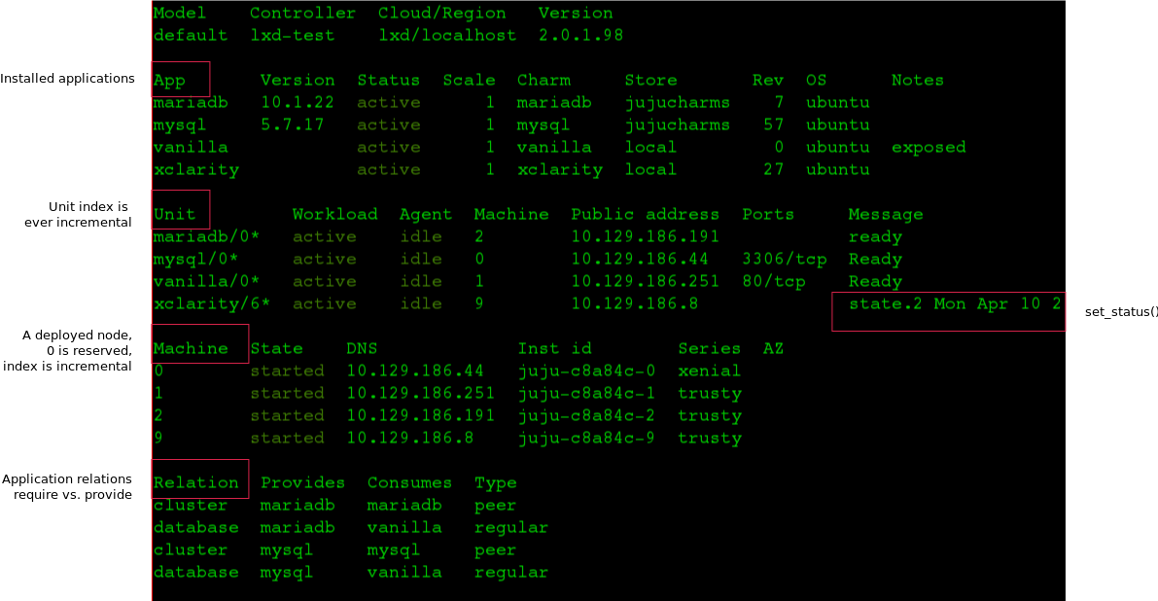
Juju status
Fig. $ juju status

Slide 30
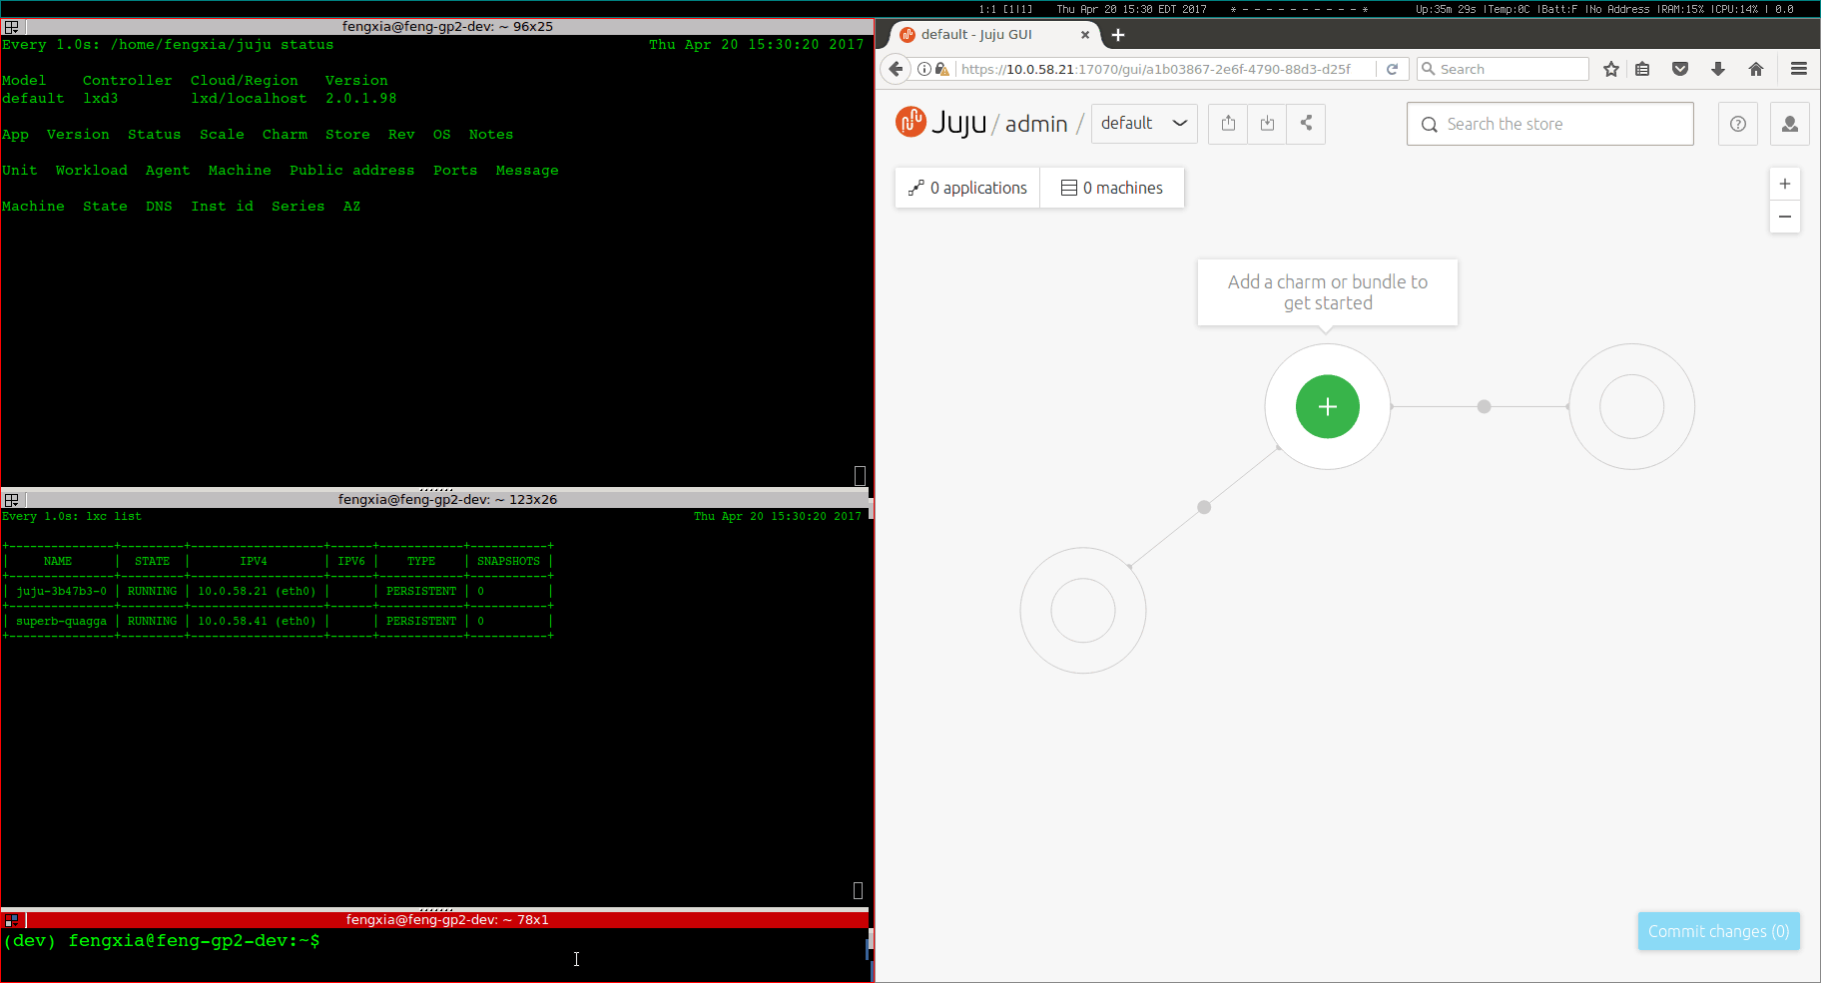
Demo: Openstack deploy (70s)
Deploy an Openstack onto LXD containers => 16 applications in 4 containers

Slide 31
Charm development

Slide 32
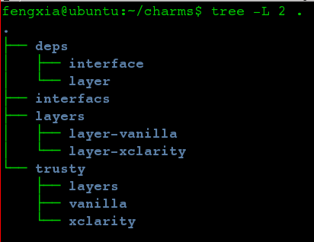
Write charm
Two ways to start
Modifying an existing simple charm that builds on “layer-basic”:
$ git clone http://github.com/juju-solutions/layer-vanilla.git
Scaffolding a template using “charm tools”:
$ charm create -t reactive-python [charm name]
Layer code
Compile charm
Charm dist dir
$ charm build
Deploy from local
$ juju deploy $JUJU_REPOSITORY/trusty/[app name] --series [xenial] –to [machine-id]

Slide 33
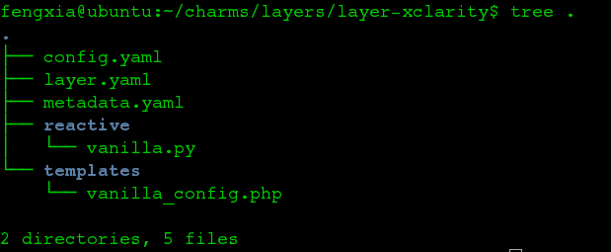
Code tree
config.yaml: config options, shows in GUI.
options:
myoption:
type: string
default: "x1"
description: “……"
metadata.yaml: charm meta. Defines charm name, compatible OS series, and relation parity.
layer.yaml (inheritance): include[“layer:basic”, “layer:yours”]. Layers are packaged inside charm dist. Configs are inherited.
interface.yaml: separate folder(INTERFACE_PATH) defining requires.py & provides.py
/reactive: custom code
Notes:
import yaml
import subprocess
from charmhelpers.core.unitdata import kv
from charmhelpers.core.hookenv import status_set
def config():
db = kv()
with open('django.yaml') as f:
django_cfg = yaml.safe_load(f.read())
for k, v in django_cfg.items():
db.set(k, v)
return db
def manage(cmd):
dcfg = config()
if not isinstance(cmd, list):
cmd = cmd.split(' ')
exe = [python(), 'manage.py']
extra = []
if dcfg.get('config-import'):
extra.append('--settings=%s' % dcfg.get('config-import'))
status_set('maintenance', ' '.join(['manage.py'] + cmd))
call(exe + cmd + extra)
def call(cmd):
dcfg = config()
subprocess.check_call(cmd, cwd=dcfg.get('source-path'))
def pip():
return config().get('pip', '/usr/bin/pip')
def python():
return config().get('python', '/usr/bin/python')
metadata
name: keystone summary: OpenStack identity service maintainer: OpenStack Charmers <openstack-charmers@lists.ubuntu.com> description: | Keystone is an OpenStack project that provides Identity, Token, Catalog and Policy services for use specifically by projects in the OpenStack family. It implements OpenStack’s Identity API. tags: - openstack - identity - misc series: - xenial - trusty - yakkety extra-bindings: public: admin: internal: provides: nrpe-external-master: interface: nrpe-external-master scope: container identity-service: interface: keystone identity-notifications: interface: keystone-notifications identity-admin: interface: keystone-admin identity-credentials: interface: keystone-credentials requires: shared-db: interface: mysql-shared pgsql-db: interface: pgsql ha: interface: hacluster scope: container domain-backend: interface: keystone-domain-backend scope: container peers: cluster: interface: keystone-ha

Slide 34
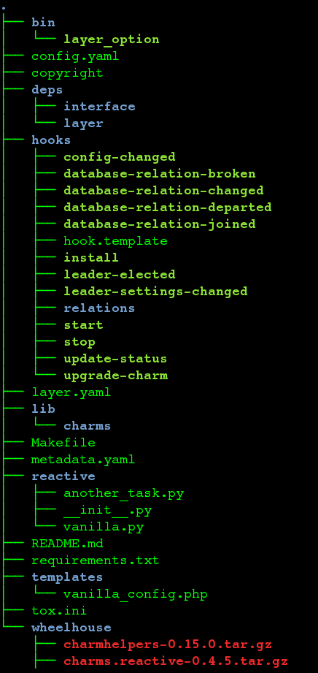
Dist tree ($ charm build)
/deps/layer
layer-basic and others (children charms)
/hooks
If not defined, it’s a copy of hook.template so they are always there.
/lib/charms
.py to install python virtualenv
Hardcoded python 3 and apt-get
/wheelhouse
charm-helpers
Charm.reactive
Notes:
import yaml
import subprocess
from charmhelpers.core.unitdata import kv
from charmhelpers.core.hookenv import status_set
def config():
db = kv()
with open('django.yaml') as f:
django_cfg = yaml.safe_load(f.read())
for k, v in django_cfg.items():
db.set(k, v)
return db
def manage(cmd):
dcfg = config()
if not isinstance(cmd, list):
cmd = cmd.split(' ')
exe = [python(), 'manage.py']
extra = []
if dcfg.get('config-import'):
extra.append('--settings=%s' % dcfg.get('config-import'))
status_set('maintenance', ' '.join(['manage.py'] + cmd))
call(exe + cmd + extra)
def call(cmd):
dcfg = config()
subprocess.check_call(cmd, cwd=dcfg.get('source-path'))
def pip():
return config().get('pip', '/usr/bin/pip')
def python():
return config().get('python', '/usr/bin/python')
metadata
name: keystone summary: OpenStack identity service maintainer: OpenStack Charmers <openstack-charmers@lists.ubuntu.com> description: | Keystone is an OpenStack project that provides Identity, Token, Catalog and Policy services for use specifically by projects in the OpenStack family. It implements OpenStack’s Identity API. tags: - openstack - identity - misc series: - xenial - trusty - yakkety extra-bindings: public: admin: internal: provides: nrpe-external-master: interface: nrpe-external-master scope: container identity-service: interface: keystone identity-notifications: interface: keystone-notifications identity-admin: interface: keystone-admin identity-credentials: interface: keystone-credentials requires: shared-db: interface: mysql-shared pgsql-db: interface: pgsql ha: interface: hacluster scope: container domain-backend: interface: keystone-domain-backend scope: container peers: cluster: interface: keystone-ha

Slide 35
CentOS compatibility
Two questions:
Will juju agent run on CentOS? Y.
Juju binaries can be executed on CentOS. Needs juju-mongo pkg.
Will Charm run on CentOS? N
Mostly Python scripts
Charms can run inside a python virtualenv
Python3 by default
Problems:
Layer-basic has hard-coded shell call to “apt-get”
http://stackoverflow.com/questions/23589971/yum-not-working, http://yum.baseurl.org/wiki/Faq
To make it work: update charm-helpers lib to implement CentOS packager.

